Slide 1
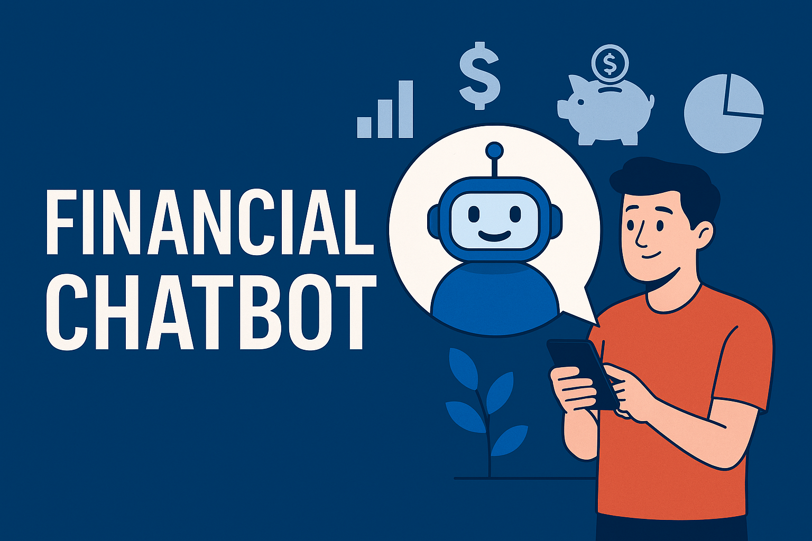
Cognitive AI Hackathon
MoneyMentor
(An AI chatbot that guides users in managing savings, investments, and taxes.)
Team Members
L. Bharat
M. Venkata Kishore
P. Jaya Ram

Slide 2
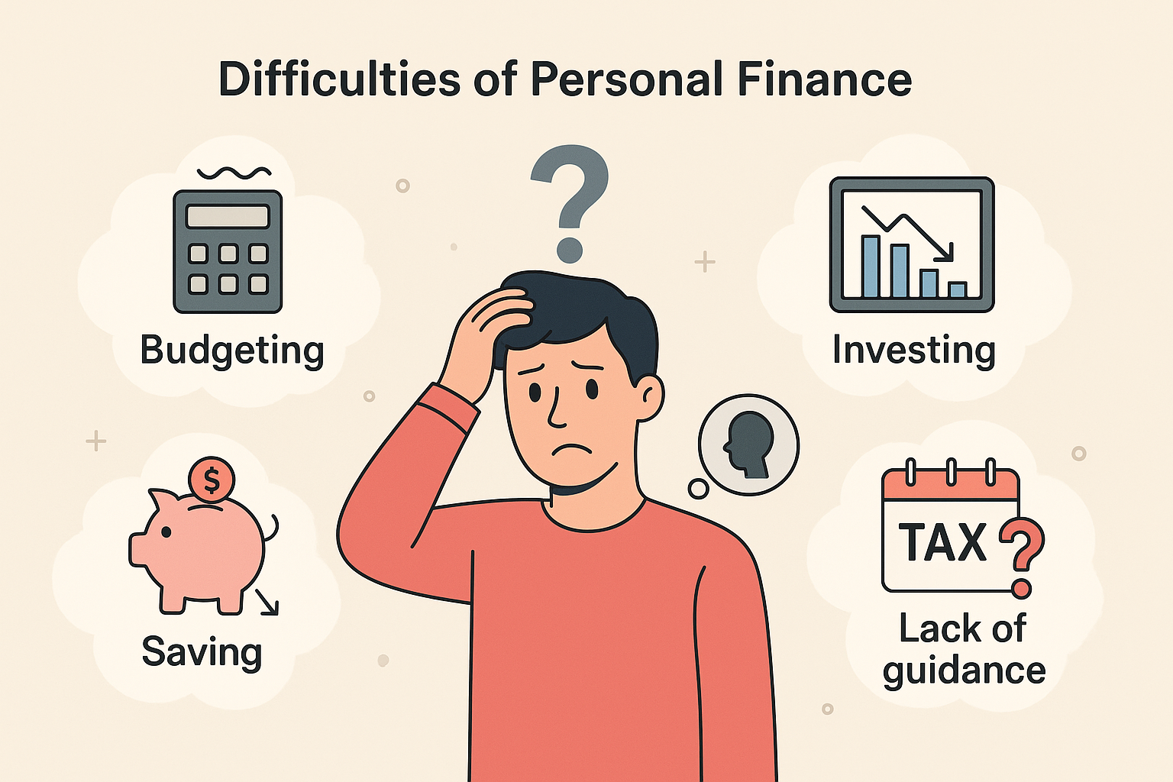
Introduction
In today’s fast-paced world, managing personal finances becomes very tough. Many struggle with budgeting, saving, investing smartly, and tax planning. Many lack awareness on how to reduce unnecessary expenses and improve savings.
Despite many tools, people lack personalized, real-time guidance—leading to confusion, missed opportunities, and poor financial decisions.

Slide 3

Solution
We propose a Personal Financial Chatbot—an AI-powered assistant that provides personalized guidance on savings, investments, and taxes.
It analyzes income, tracks investments, suggests tax-saving actions and simplifies planning through a secure, user-friendly chat interface—empowering smarter financial decisions, designed for users of all experience levels.

Slide 4
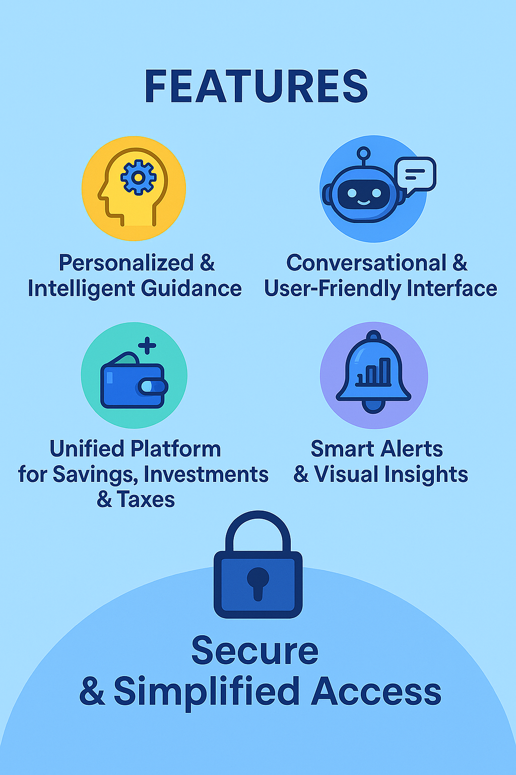
Features of the Proposed Solution
Secure Access – Safe login with personalized experience.
Conversational Interface – Easy, chat-based financial help.
AI Insights & Visuals – Smart tips with clear dashboards.
Personalized Guidance – Tailored advice on money matters.
Smart Reminders – Alerts for bills, taxes, and goals.
Data Integration – Syncs bank and investment data.
User-Friendly Design – Simple, responsive across devices.

Slide 5
Workflow Diagram
User Login/Sign up
Savings
Investments
Taxes
Enter income & Expenses
Shows our Portfolio
Enter tax related details
Visual Analytics & Suggestions to reduce expenses
Suggestions to Improve our Investments
Visual Analytics & Suggestions
Note : Chatbots available in all sections for Personal Assistance

Slide 6
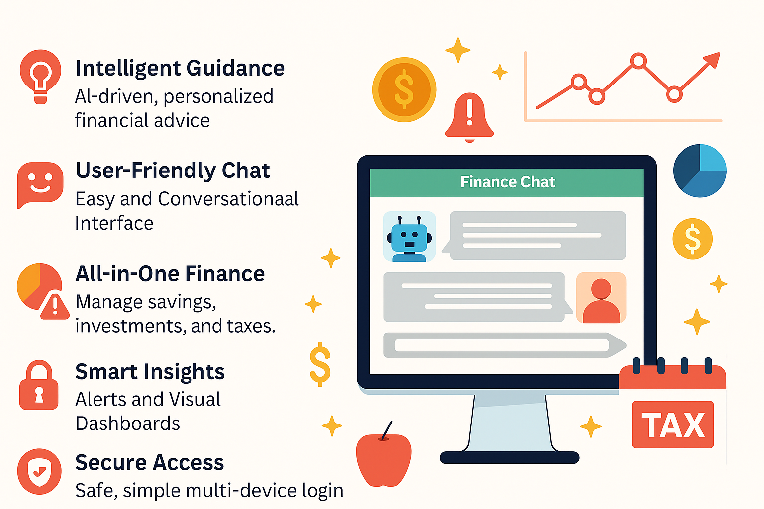
Novelty/Uniqueness
Smarter finance, simplified life — with AI guidance, seamless interaction, and all-in-one control.
Intelligent Guidance – AI-driven, personalized financial advice
User-Friendly Chat – Easy and Conversational Interface
All-in-One Finance – Manage savings, investments, and taxes.
Smart Insights – Alerts and Visual Dashboards
Secure Access – Safe, simple multi-device login.

Slide 7
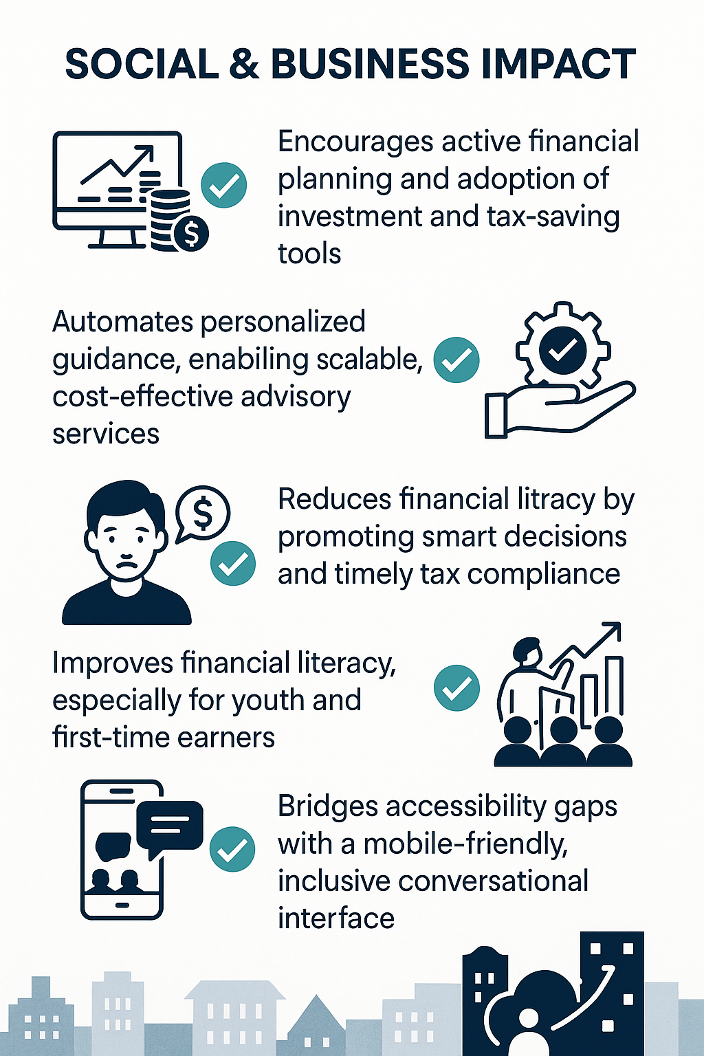
Business/Social Impact
Encourages active financial planning and adoption of investment and tax-saving tools.
Automates personalized guidance, enabling scalable, cost-effective advisory services.
Reduces financial stress by promoting smart decisions and timely tax compliance.
Improves financial literacy, especially for youth and first-time earners.
Bridges accessibility gaps with a mobile-friendly, inclusive conversational interface.

Slide 8
Technology Stack
Backend: Python – Core logic, data processing, and integration.
AI/NLP: HuggingFace Transformers – Custom language models for financial dialogue and text classification, Granite – For intelligent, financial-focused chatbot interactions.
Frontend & Visualization: Streamlit charts - For investment performance, savings breakdowns, and tax timelines , Plotly – For an interactive UI with charts and dashboards.
Database & Auth: Firebase / MongoDB – For secure user data, authentication, and financial records.
APIs: Alpha Vantage - For real-time stock/investment data, Govt Tax APIs – To fetch real-time financial and tax-related data.

Slide 9
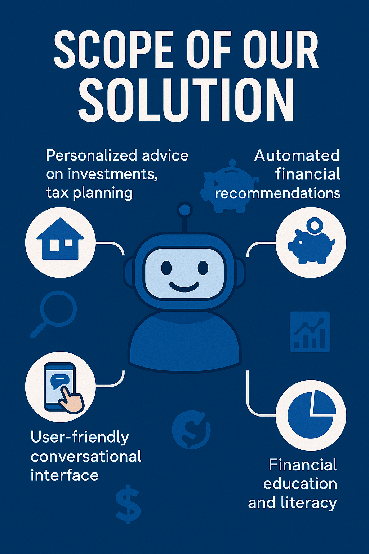
Scope of the Solution
The Personal Financial Chatbot empowers users with AI-driven, real-time insights for smarter financial decisions. It integrates savings, investments, and tax planning into a single, user-friendly platform.
Designed for users of all experience levels, it simplifies budgeting, tracks investment performance, and ensures timely tax compliance.
Its mobile-first, scalable architecture makes it ideal for integration with fintech services and extending financial literacy to underserved and rural communities.

Slide 10
Conclusion
In conclusion, our AI-powered Personal Financial Chatbot redefines how individuals manage their money—bringing clarity, confidence, and control to their financial journey. By offering personalized insights, simplifying complex decisions, and promoting financial literacy, it empowers users to make smarter, stress-free financial choices every day.
“A budget is more than numbers on a page; it is an embodiment of our values.” - With the right tools and guidance, financial stability is not just a goal—it becomes a way of life.

Slide 11
Thank You

